Slide 1
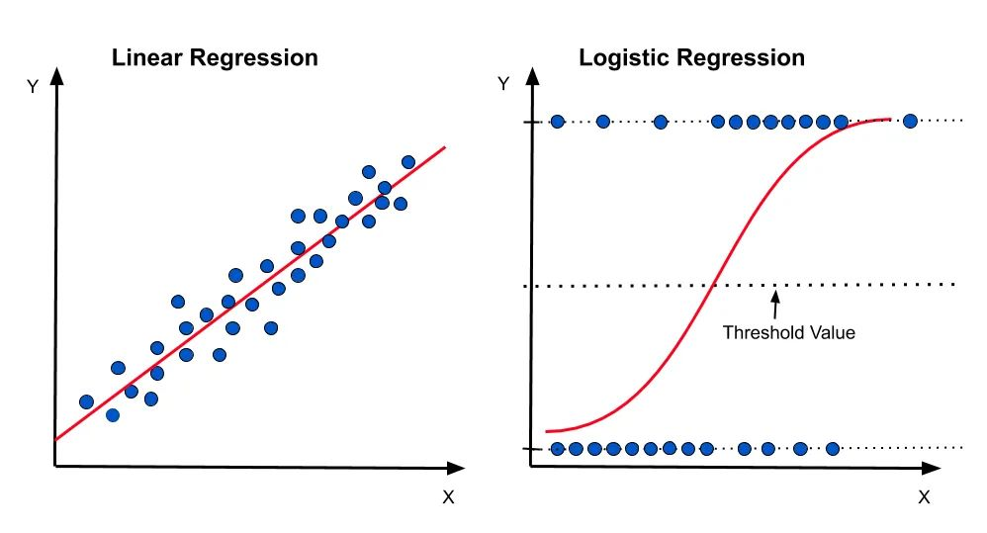

Logistic Regression
Used to predict the probability of a binary or categorical variable
Cancer/No cancer, Buy/No buy, probability of a heart attack, …
Predicted values in a probability range between 0 and 1
One or multiple independent variables(predictors)
Inappropriate when: non-linear relationship, missing data, outliers,
multicollinearity, small sample size
How does the model work?
When it should/should not be applied?
Basic example/illustration
Learning Strategy:
Supervised Learning
Analytics Target:
Classify observations into one of
two categories
logit(p) = β0 + β1x1 + β2x2 + ... + βnxn
P: probability
Β0: intercept
Β1, …, βn: coefficients of the independent variables

Slide 2
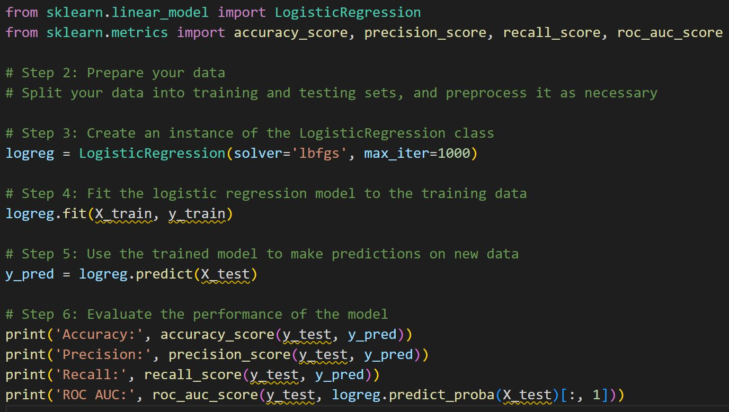
Logistic Regression
How to apply using sklearn:

